Slide 1


Automotive Electronics Course Project
Cruise Controller using PID Controller
Team-08
SL.NO. | NAME | USN | ROLL NO.
01 | Praveen Magadum | 02FE21BEC064 | 59
02 | Komal Melavanki | 02FE21BEC042 | 38
03 | Bhuvan Budavi | 02FE21BEC021 | 18
04 | Bhakti Betageri | 02FE21BEC019 | 16
Department of Electronics and Communication Engineering,
KLE Technological University’s Dr. M. S. Sheshgiri College of Engineering and Technology, Belagavi

Slide 2
Problem Statement
Design and Implement a Cruise control system using PID Controller.

Slide 3
Introduction
The cruise control system interacts with the driver, the speed control device (throttle) and the external environment despite various interfaces in order to keep the speed of the car as desired by the driver.
It serves as a cornerstone for efficiency optimization. By orchestrating precise adjustments to engine output, cruise control systems optimize fuel consumption, promoting eco-friendly driving practices and reducing carbon footprint.
The user requests activation of the cruise control. The cruise control system accepts inputs from the sensor and gives a signal to the throttle mechanism for adjustment in the desired position.
After the throttle is set, the cruise control system gives the user a feedback that it is now active and set.

Slide 4
Objectives
Maintain Constant Speed
Enhance Fuel Efficiency
Increase Driver Comfort and Convenience
Improve Safety
Support Adaptive Cruise Control (ACC)

Slide 5
System Description
Components of Cruise Control System
Control Module (ECU)
Speed Sensor
Throttle Actuator
Basic Functionality
Activating Cruise Control
Maintaining Speed
Deactivating Cruise Control
Advanced Features (Adaptive Cruise Control - ACC)
Radar and Camera Sensors
Automatic Speed Adjustment
Collision Avoidance

Slide 6
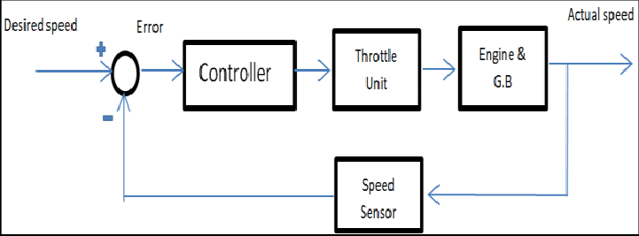
System Description
BLOCK DIAGRAM

Slide 7
Cruise control Design:
A simple cruise control system with PID controller, design done in Simulink.
The cruise control system design is for a Compact Sedan (system parameters for modelling such as weight of the car, dimensions, drag coefficient, rolling resistance, max torque and so on has been for a Honda City 1.5L)
System is first-order mass damper model, the modeling has been done in simulink in both discrete and continuous modes, with and without a PID controller. The tuning of the PID parameters has been done using the matlab pid tuner tool. The system objective was to maintain the speed of the car at 100 km/h (27.78 m/s). System stability was checked by applying disturbance similar to that of a car running from a plain road to an inclined terrain. Rise time is designed to be less than 12 seconds, as the car in modelling (honda city 1.5l) can do 0-100km/h in 10.8 seconds.

Slide 8
Working Principle
Setting the desired speed
Feedback Loop- The measured speed is fed back to the summation block to continuously update the error and refine the control signal.
Error Calculation - The system calculates the error by comparing the actual speed with the desired speed.
Speed Measurement - The actual speed of the vehicle is measured, converted to different units, and displayed on the speedometer.
PID CONTROL - The PID controller processes the error to determine the appropriate control action (throttle adjustment) to minimize the error.
Actuation - The control signal is adjusted by the actuator and any external disturbances are accounted for.
Vehicle Dynamics - The adjusted control signal is applied to the vehicle model (Plant), resulting in a change in vehicle speed.

Slide 9
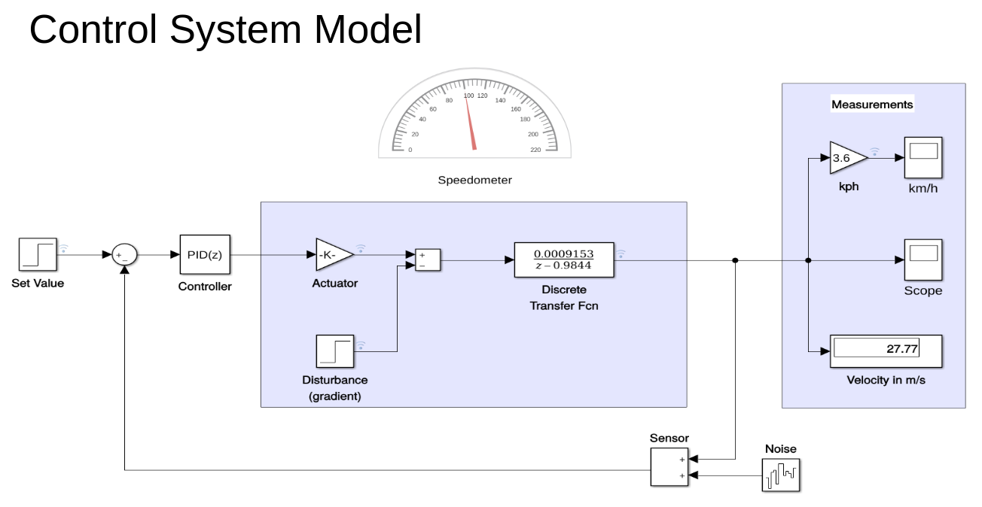
Simulink Model

Slide 10
Simulink Model Overview
Set Value : This block defines the desired speed of the vehicle. It’s the reference input for the system, typically provided as a step input to represent a change in the desired speed.
Summation Block : This block calculates the error by subtracting the actual speed (feedback) from the set value (reference input). The output is the error signal, which is fed into the PID controller.
PID Controller (PID(z)):This block represents a discrete PID controller. It processes the error signal to produce a control signal aimed at reducing the error over time. The discrete PID controller uses Proportional, Integral, and Derivative terms to adjust the control effort dynamically.
Actuator : This block models the actuator dynamics. The gain block (labeled with -K) adjusts the magnitude of the control signal before it is applied to the system.
Disturbance (Gradient):This block simulates external disturbances, such as changes in terrain gradient, affecting the vehicle’s speed. It adds these disturbances to the control signal to account for real-world scenarios.

Slide 11
Simulink Model Overview
6. Discrete Transfer Function: This block represents the discrete-time transfer function of the vehicle dynamics. The transfer function 0.0009153z−0.9844\frac{0.0009153}{z - 0.9844}z−0.98440.0009153​ models the relationship between the control input and the vehicle speed.
7. Sensor:
This block represents the speed sensor. It measures the actual speed of the vehicle. The sensor signal is fed back to the summation block to form a closed-loop system.
8. Noise:
This block simulates sensor noise, adding randomness to the measured speed to represent real-world sensor inaccuracies.
9. Measurements:
This subsystem converts the vehicle speed from meters per second (m/s) to kilometers per hour (km/h) using a gain block (multiplying by 3.6). It includes a scope for visualizing the speed signal in km/h.
10. Speedometer:
This visual component displays the vehicle speed in real-time in km/h, providing an intuitive interface for observing the speed.

Slide 12
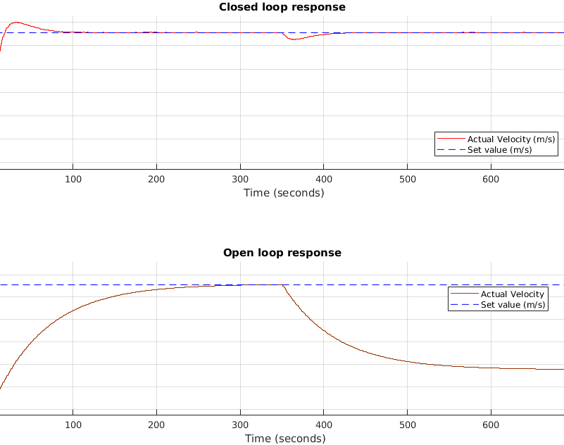
RESULTS
By comparing these waveforms, We can clearly see the advantage of using a closed-loop control system for maintaining the desired speed accurately and quickly, which is essential in applications like cruise control in vehicles.

Slide 13
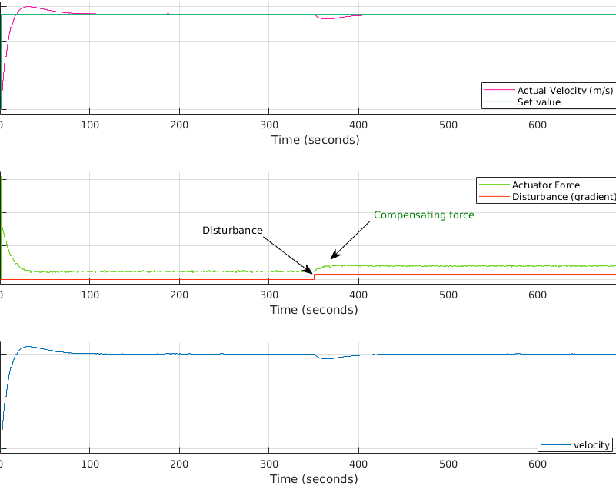
RESULTS
The waveform demonstrates the resilience and accuracy of a closed-loop control system in maintaining the desired speed even when external disturbances are introduced. The controller effectively mitigates the impact of disturbances, ensuring the system's performance remains within acceptable limits.

Slide 14
CONCLUSION
We demonstrated the design and implementation of a PID-controlled cruise control system using MATLAB Simulink. The closed-loop system provided superior performance in maintaining the desired speed, effectively handling disturbances and noise. These results reinforce the advantages of closed-loop control systems in automotive applications and provide a strong basis for further research and development in this field.

